Slide 1

Gesture Based UI Project
By Sean McGuire

Slide 2

Introduction
My project is using the Myo Armband to connect to a desktop-based game built in unity called “Myo Drag Racing”.
The aim of the game is to change gear at the right time to increase the speed of the car and beat the opponent.
The user uses the Myo armband to change the gear using the “Double tap” gesture.
This is built using the Myo SDK toolkit and the Unity framework.

Slide 3

Technologies used
Unity app development
Myo SDK
GitHub

Slide 4
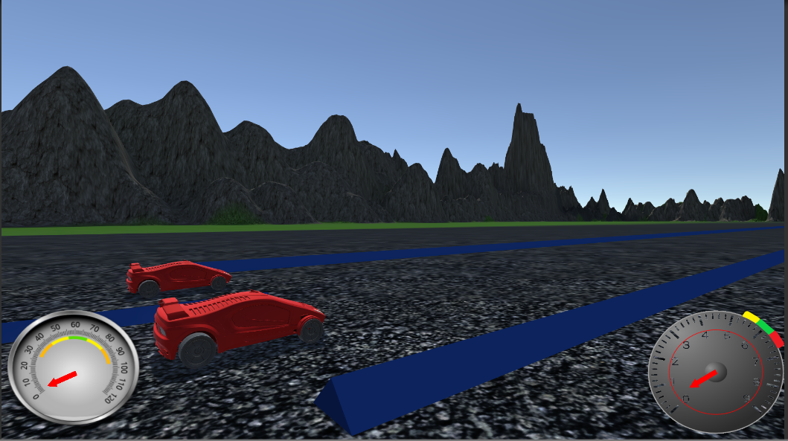
What the game looks like:

Slide 5
Overview
So far, I have completed:
Getting the Myo armband to connect to Unity.
The on-screen UI with the speedometer and the tachometer.
The terrain, AI car and user controller car.
Game completion implementation (finish line).
The users gear changing mechanic (with sounds).
3,2,1,GO animation.
Menu System with settings.

Slide 6
Gestures used
So far, the only gesture is double tap.
Future development will include “fist clench” in order to give the car a boost.

Slide 7
Questions?

